Slide 1
Anglo Saxon Poetry
The Seafarer + The Wanderer

Slide 2
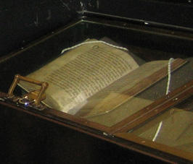
The Exeter Book
Mysterious book of Anglo-Saxon poems dating from around the middle of the tenth century.
The largest of the few significant collections of Anglo-Saxon poetry still surviving.
Contained 30+ poems and ninety riddles.
Bishop Leofric gave the manuscript to the cathedral at Exeter.
Written down by monks around 975, date of composition is unknown but prior to that date.

Slide 3
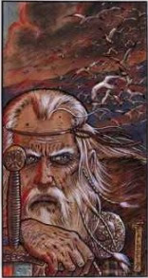
The Seafarer
Most often considered an elegy, or mournful, contemplative poem.
Can also be considered a planctus, or “complaint.”
A planctus generally involves a fictional speaker discussing loss of some kind (could be death)
Strong emotion is the key.

Slide 4
The Seafarer
Speaker is a sailor who has endured many harsh winters at sea.
He considers it a cold place yet longs for it.
Becomes a metaphor for life.
Contains both Christian and non Christian elements.

Slide 5
The Seafarer
Comparisons between
the land and safety/security.
The sea and hardship/struggle
The sea and the power of God.
“Home” and being closer to God.

Slide 6
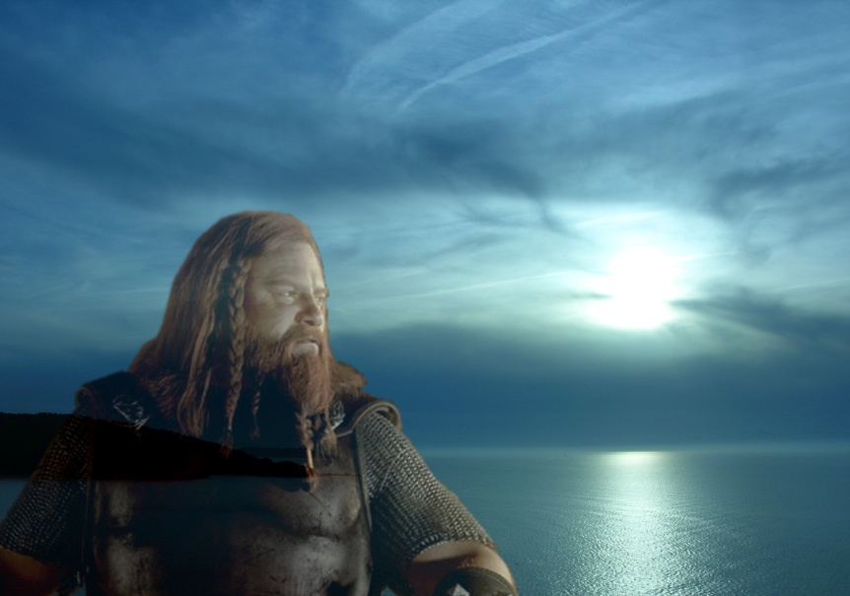
The Wanderer
Elegiac poem
Contains homily elements
Connections can be drawn to current day wanderers
Pay attention to last lines – What change is there?

Slide 7
The Wanderer
Speaker is a warrior recalling battles in which those closest to him were killed.
Extrapolates idea outward, speaking of fortune, friendship, and sadness of life
Exile plays a dominant role.
Ends with a twist – Why?

Slide 8
Metaphor
A direct comparison of two things, often unrelated. A verbal equation results where both "parts" illuminate one another.
Genius is a fountain
His fist was a hammer
The building is a diamond in the sky

Slide 9
Alliteration
Repetition of initial consonant sound.
“the frog frolicked frivolously on the forest floor.”
“…Little skinny shoulder blades Sticking through your clothes…”
“…struck by a steed flying fearless and fleet…”

Slide 10
Kenning
A compound expression with metaphorical meaning, often used in place of a noun.
A literary device in which a noun is renamed in a creative way using a compound word or union of words to combine ideas.
The best kennings are short and often create an unexpected comparison

Slide 11
Examples
Sky-candle = The sun
Swan-road = The sea/sky
Stout-hearted = Brave
Battle-sweat = Blood
Dwelling place = Home
Earth-hall = Grave
Helmet bearers = Warriors

Slide 12
Kennings in Beowulf
“bone-house” = body
“gold-friend of men” = generous prince
“ring-giver” = lord
“flashing light” = sword

