Slide 1
Hero Types

Slide 2
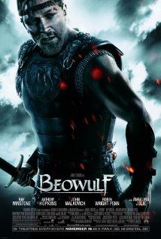
The Classic Hero
Goes on a quest to achieve some good which benefits other people.
Perhaps they are rescuing a maiden in distress or preventing a dastardly villain from ruling the world.
We look up to the Classic Hero but may not fully believe their perfection. Nevertheless they are a clear ideal to which we can aspire.

Slide 3
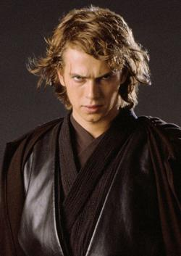
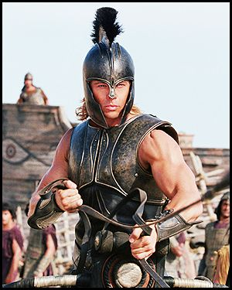
The Tragic Hero
Doomed from the outset, yet continues the quest. Often achieves it just before tragic death.
Can fail in quest, having bit off more than they can chew.
Represents basic human fear. Despite all our effort, we may still fail.
Bullets do not always miss the tragic hero.

Slide 4
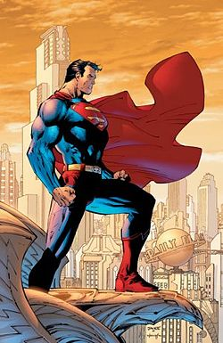
The Super Hero
Exaggeration of the classic hero’s ability to succeed.
Possesses super-human powers, such as Superman.
Often have human weaknesses, though generally very few.
The Super-hero story features same archetypes over and over again. Evil villain, stupid henchmen, etc.
The Super-hero represents our dreams in which we can fly and have super-human strength.

Slide 5
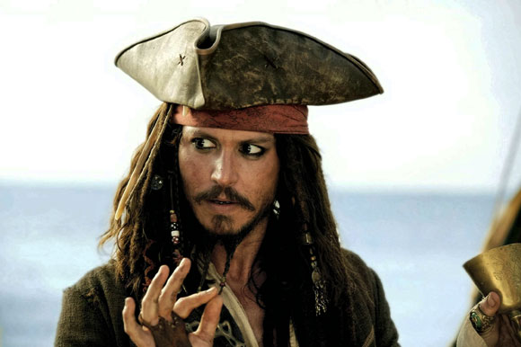
The Anti-Hero
Lacks typical attributes associated with heroes (Nobility, high purpose, great powers or skills, etc.)
The Anti-hero is a hero the audience does not always like.
Their feelings of indifference or distraction irritate us as they seem determined not to be heroic
When the chips are down they ultimately deliver.
Anti-heroes can be frustrating for the audience, but they do increase anticipation and excitement as we wonder what they will do next.

Slide 6
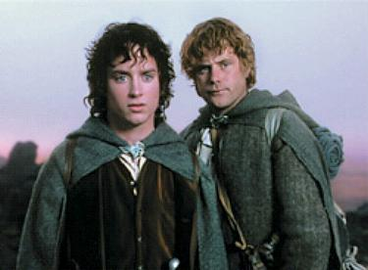
The Accidental Hero/Common Man
Happens to get in the way of adventure and is swept into the action.
Often protests.
Perhaps their car is hi-jacked by gunmen or they are in a plane that crashes on a desert island. Which ever way, they are thrust into the main storyline and somehow manage to succeed.
We associate more easily with the Accidental Hero as they generally represent the common person more than other heroes.
Comedic elements as they stumble through the plot and we laugh at them.

Slide 7
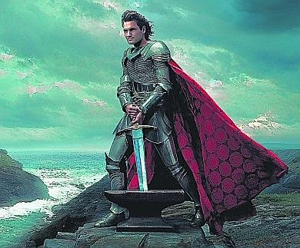
The Knight
Driven by knightly code of honor that demands bold acts and confrontation of evil wherever it may be found.
The Knight thus rescues maidens but does not woo them, preferring instead to preserve a distant purity.
We tend not to associate directly with the Knight but they often represent the rescue we desire in our moments of stress.

Slide 8
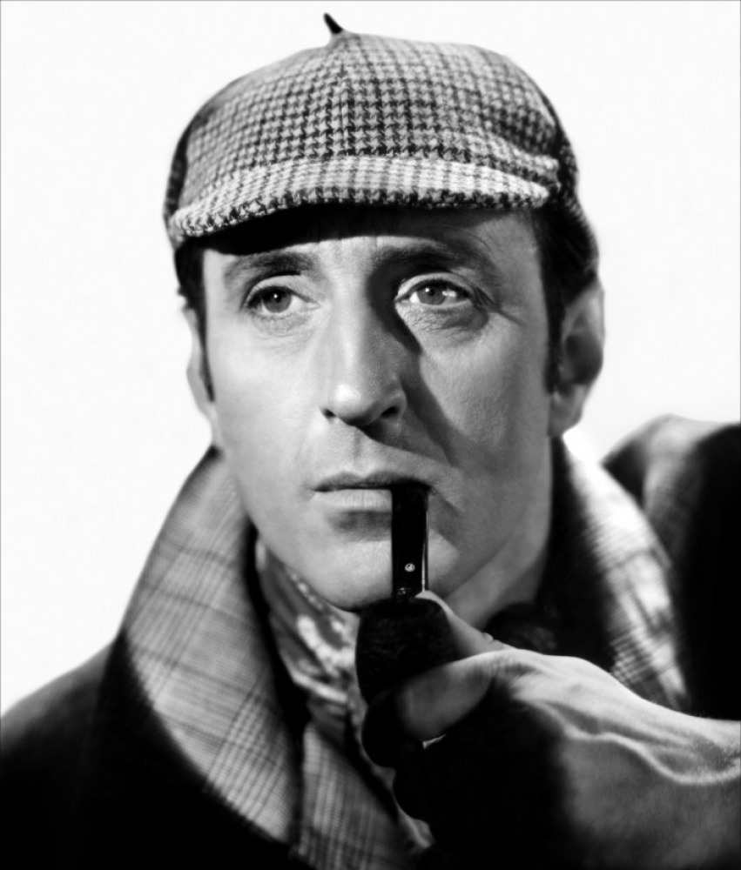
The Genius
Highly intelligent person who uses brain-power to solve problems. No problem is too tough.
Geniuses may play in supporting roles, but can also take on the leading role. They are often nerdy, lacking social skills, but make up for this with their intellect.
We may well envy their mental powers but are grateful that they are on the side of good.

Slide 9
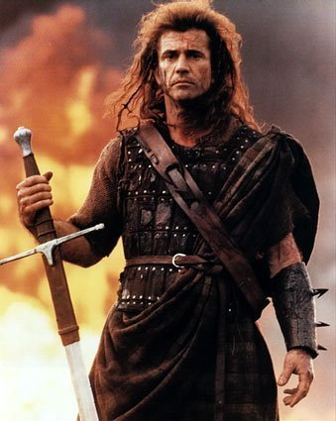
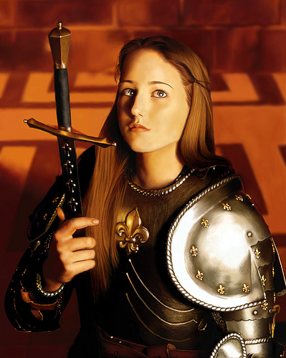
The Leader
Directs the troops, often from the front lines.
Main skill is in inspiring and motivating others, although they also need to be able to determine which direction to lead their party.
The Leader can represent a parent or teacher who tells you what to do.

Slide 10
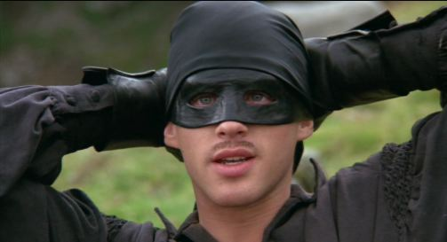
The Bold Adventurer
Primary goal is excitement and stimulation rather than achievement of a goal.
May achieve a goal but that is not where thrill comes from.
The Adventurer steps into the unknown with a smile on his face.
May not attract followers like a leader, but will produce action.

Slide 11
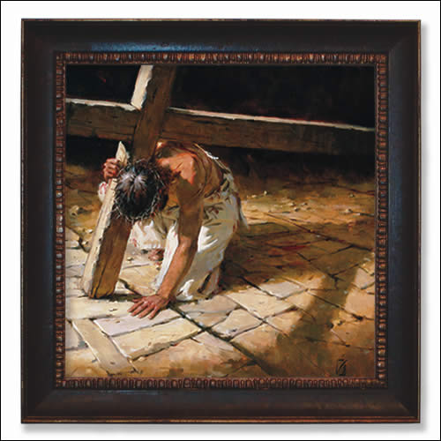
The Martyr
The Martyr sacrifices self in the name of a greater cause or the safety of others.
Transcends our deep fear of death.
This putting of others before oneself is a characteristic of most other heroes and martyrdom is a potential and defining route for any heroic action.
We may have great admiration for those who lay down their lives for their countries or their faiths.

