Slide 1
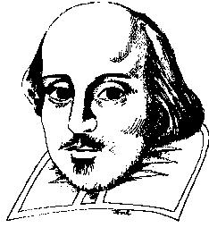
William Shakespeare and Macbeth

Slide 2
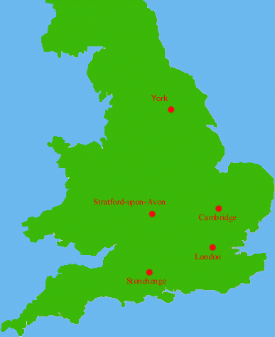
Shakespeare’s Life: 1564-1616
Born in Stratford-upon-Avon, Warwickshire.
Baptized on 26 April 1564, likely born three days earlier. (April 23, 1564)
Married in 1582 to Anne Hathaway.
Was working on plays and sonnets in London by 1592.
Died in 1616.
36 of his plays published for the first time in The First Folio in 1623.

Slide 3
Works
Plays
Shakespeare wrote comedies, histories, tragedies, and romances.
14 comedies
10 histories
10 tragedies
4 romances
Possibly wrote others (The Lost Plays [3-11?])
Collaborated on several others
Some Play Dates
Note: These dates are historical guesses. Exact dates are not known.
1589 - first play is Henry IV Part One
1590-91 - Henry IV Parts II and III
1593 - Two Gentlemen of Verona
1594 - Taming of the Shrew
1595 - Romeo and Juliet, A Midsummer’s Night Dream
1605 - Macbeth, King Lear (To honor King James)
1610 - Othello
1611 - The Tempest
Poetry
154 Sonnets
Many other poems

Slide 4
Shakespeare’s English
The following phrases were coined by Shakespeare. What do they mean and how do we use them today.
A laughing stock (The Merry Wives of Windsor)
A sorry sight (Macbeth)
As dead as a doornail (Henry VI)
Eaten out of house and home (Henry V, Part 2)
Fair play (The Tempest)
I will wear my heart upon my sleeve (Othello)
In a pickle (The Tempest)
In stitches (Twelfth Night)
In the twinkling of an eye (The Merchant Of Venice)
Mum's the word (Henry VI, Part 2)
Neither here nor there (Othello)
Send him packing (Henry IV)
Set your teeth on edge (Henry IV)
There's method in my madness (Hamlet)
Too much of a good thing (As You Like It)
Vanish into thin air (Othello)

Slide 5
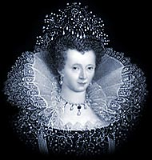
Macbeth Time Period - Elizabethan England
Queen Elizabeth I - born September 7, 1533 in Greenwich
Died March 24, 1603 in Richmond, Surrey
Daughter of King Henry VIII and Anne Boleyn (beheaded by Henry for not bearing a son)
Coronated January 15, 1559. Ruled until 1603.
Spoke Greek, French, Italian, Latin, and, of course, English.
Never married and was nicknamed, "The Virgin Queen.”
Elizabethan age was height of English Renaissance in music, literature, military strength
Also saw the birth and rise of William Shakespeare, most famous English play write of all time
Elizabethan age was height of English Renaissance

Slide 6
The Tudors and Stuarts
Ruling families of England and Scotland.
Tudors = England
Stuarts = Scotland (Later England)
There was no Tudor successor to the throne of England.
Elizabeth I had been instrumental in the death of her cousin, Mary Queen of Scots, who was beheaded.
James VI of Scotland succeeded Elizabeth following her death. At this point, in 1603, James VI of Scotland became James I of England.

Slide 7
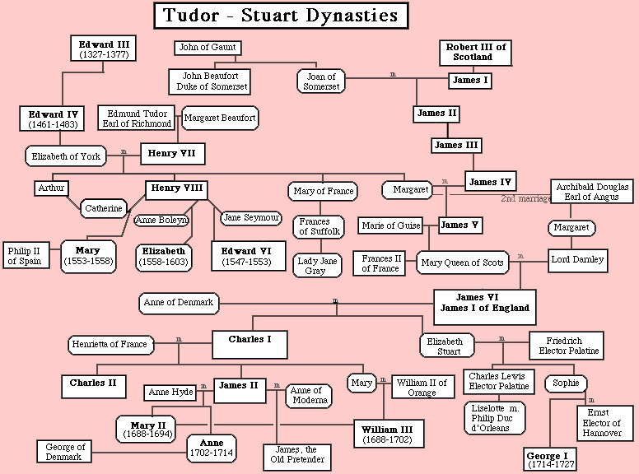

Slide 8
The Tudors and Stuarts
Debates over Elizabeth’s successor
Some say she chose James VI to become the next King of England in order to “ease her way into heaven.” Others say she never chose a successor. Regardless, James’ accession was unopposed.
The appointment of James I was a good political move, unifying England and Scotland under one King.
Due to all of this, The King of England in 1606 was James I, a Stuart. He was appointed in 1603.

Slide 9
Macbeth - Pre-Reading Information
Macbeth is the tale of a good and brave Scottish general who, encouraged by three evil witches and his own wife, becomes too ambitious for his own good.
The story is a tragedy that demonstrates how a single flaw can bring about one’s destruction.
Shakespeare wrote the play for James I, England's new king, previously the king of Scotland.
To please James, Shakespeare set the play in Scotland, used many characters who were James' ancestors.

Slide 10
Macbeth - Pre-Reading Information
Shakespeare included witches in the play because King James was highly interested in the subject and had written about it.
The play is Shakespeare's shortest tragedy, probably because King James often fell asleep during performances.
Shakespeare's source for the story of Macbeth was The History and Chronicles of Scotland (1526), written by Hector Boece, a Scottish historian.
Many scholars question the factual reliability of Boece's work, and point out that Shakespeare took liberties with Macbeth's history for dramatic purposes.

Slide 11
History & Macbeth – A True Story?
Macbeth was a real king of Scotland
He took the throne by killing King Duncan
In actual history, Banquo was in collusion with him
Historical Macbeth reigned from 1040-1057
Unlike the Macbeth in Shakespeare’s play, the real Macbeth:
had a legitimate claim to the throne
was popular and a strong leader
had a successful reign
was killed at Lumphanan as opposed to Dunsinane

Slide 12
Before the Curtain Opens
When the play begins, there are two wars in progress:
Civil War - King Duncan vs. Macdonwald’s rebels
National War - Scotland, led by King Duncan, against invading Norway, led by King Sweno
These two events took place at different times. Shakespeare combines them.

Slide 13
What did Shakespeare change?
Shakespeare’s changes the ways in which characters act and are killed.
History represents Banquo as equal in guilt with Macbeth—Shakespeare whitewashes Banquo’s character as a compliment to King James
History makes no mention of Lady Macbeth—her character is almost wholly the creation of Shakespeare
In history, Macbeth fled before Macduff—Shakespeare shows Macbeth bravely fighting

Slide 14
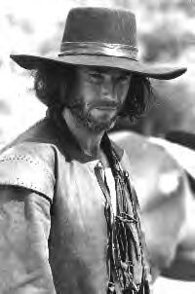
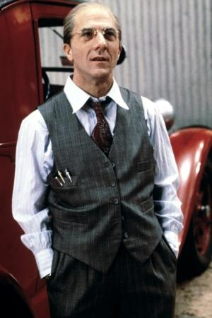
The Tragic Hero
“Man of high standard who falls from that high because of a flaw that has affected many” – Aristotle
Macbeth is arguably the most famous example of the tragic hero.
Macbeth
Willy Loman
John Proctor

Slide 15
Characteristics of Tragic Hero
Person of nobility: King, general, nobleman.
Must have some good characteristics/virtues. Matters to us and seems worthwhile.
Due to position, his actions must have far-reaching effects.
One character trait that could be good must prove to be a fatal/tragic flaw.
Already great, shows promise of further greatness. (Could be even better)
Makes serious errors in judgment, which lead to the deed that causes his downfall.
Must be responsible for the deed which causes his downfall.
Has a distorted perception of, or is blind to, reality.
Suffers outwardly and inwardly
Elicits pity and fear from the audiences.
Often recognizes mistakes too late
Dies.

Slide 16
Characters
Macbeth
Scottish General and thane (Scottish Lord) of Glamis.
Highly ambitious. Wants more than he has.
Never fully comfortable committing immoral acts.
Sparked by an idea he receives from withches.
Supposed to serve King Duncan.

Slide 17
Characters
Lady Macbeth
Macbeth’s wife
Hungry for power. Wants big things for her husband and herself.
Seems ruthless early on in the play.

Slide 18
Characters
Three Witches
Involved in dark arts, especially prophecies/foretelling the future
Choose Macbeth as their victim.
Identities remain unclear throughout play.
Servants of Hecate.

Slide 19
Characters
Banquo
Brave, noble Scottish General.
Friend and ally of Macbeth at first.
Also has run in with the witches.
Ultimately chooses different path than Mancbeth.
Father of Fleance.

Slide 20
Characters
Duncan
Good King of Scotland
Virtuous, wise, kind ruler.
King who Macbeth and Banquo serve.

Slide 21
Characters
Malcolm
The eldest son of Duncan.
Older brother of Donalbain.
Will flee Scotland to England.

Slide 22
Characters
Donalbain
The youngest son of Duncan.
Younger brother of Malcom.
Will flee Scotland to Ireland.

Slide 23
Characters
Macduff
Scottish Nobleman.
Ultimately disagrees with Macbeth on many things and comes to hate him.
Husband of Lady Macduff and father of a young son.

Slide 24
Characters
Hecate
Goddess of witchcraft.
Leader of the witches.
Very mysterious. Motivation never fully revealed.

