Slide 1
Introduction to the Canterbury Tales
By Geoffrey Chaucer

Slide 2
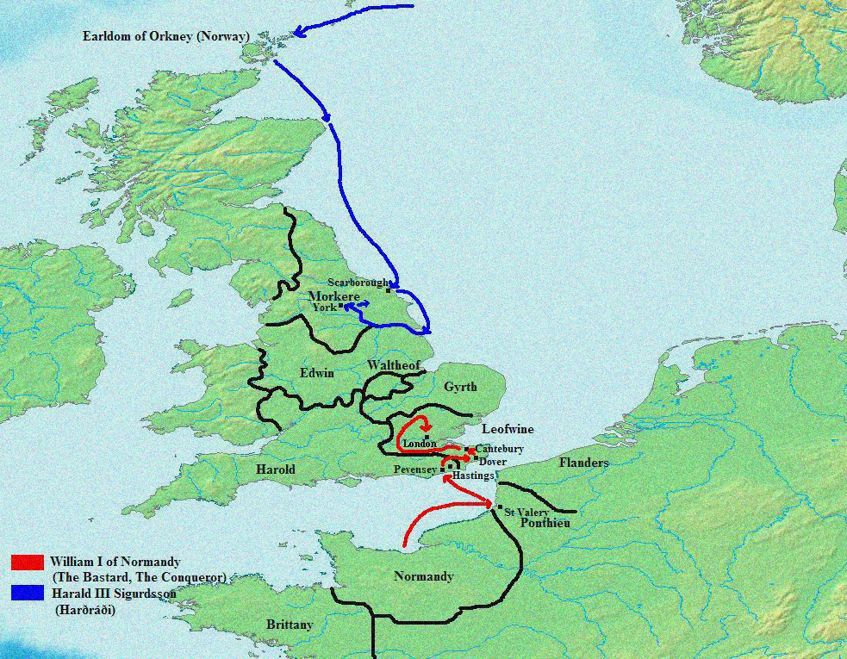
The Norman Invasion and the English Language
In 1066 the Normans conquer England.
The Normans spoke French. For many years, French/Latin = languages of court, religion and science
Old English is pushed to the backburner.
Soon English is only used by the common people.
Ruling class and lower class speaking different language could not last. The Normans had to learn some English to communicate.
In 13th century, England lost control of its French territory, and the Norman nobility had to declare allegiance either to France or to England. Many of them chose England, because they were born there.

Slide 3
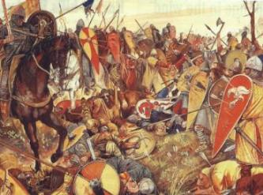
The Rise of English
During the late 13th/14th century, English makes comeback.
The mood towards France becomes hostile. It is no longer viewed as a mother country, but as a dangerous rival.
Although French and Latin were still languages of prestige, over time English slowly became language of communication, even among the nobility.
The Hundred Years’ War with France (mid-14th – mid-15th cent.) marked the final decline of French and the rise of English as a chief language.

Slide 4
Literature in Middle English
What we now call Middle English appears in the late 14th century.
This time period produced the first great age of secular (not religious) literature.
The best representative of this is Geoffrey Chaucer, ‘the father of English poetry’.
By making a conscious choice to write in English, Chaucer symbolizes the rebirth of English as a national language. His works also helped the London dialect of English become a standard.
We can read and understand Chaucer’s English fairly well – this shows how much the language had changed.

Slide 5
The Printing Press
William Caxton set up the first English printing press in 1476.
He printed works of Chaucer and Malory, and also books from other countries translated by himself into excellent English prose.
Major influence on the spread of learning and knowledge, a ‘communications revolution’.
William Caxton’s choice to print the language/dialect of London was crucial. It became the standard.

Slide 6
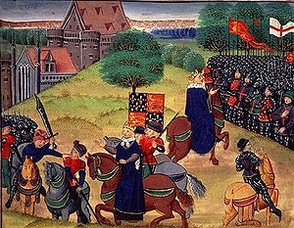
Style: Historical context and themes
Turbulent time in English history.
The Catholic Church was in the midst of the Great Schism and, though it was still the only Christian authority in Europe, was the subject of heavy controversy.
After the Black Death (1348-1350), many Europeans had begun to question the authority of the Catholic Church in various ways.
Some chose less extreme paths, starting new monastic orders or smaller movements exposing church corruption in the behavior of the clergy, false church relics or sale of indulgences (payment for forgiveness of sins).
Several characters in the Tales are religious figures, and the very nature of the pilgrimage to Canterbury is deeply religious, making this a major theme of the work.

Slide 7
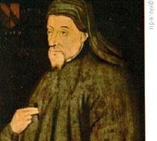
Geoffrey Chaucer c. 1343-1400
Considered the father of English poetry.
Wrote in the vernacular – common language of the people (English)
Introduced rhymed stanzas of different types and iambic pentameter
First writer buried in Westminster Abbey
Chaucer’s characters are seen as real, both good and bad sides.
Rhyme takes place of Old English alliteration

Slide 8
Chaucer’s Life
During his life Chaucer was a:
Soldier
Courtier
Royal emissary to Europe
Controller of customs
Justice of the peace
Member of Parliament
Artist
Notes:
Chaucer’s background enables him to give us a rich and varied portraits of contemporaries from every walk of life
Born around 1340

Slide 9
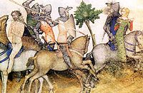
The Canterbury Tales
Most famous work= The Canterbury Tales
Written between 1387-1400
The Canterbury Tales demonstrates conflict between classes and the changing times.
Most of the tales are interlinked by common themes, and some reply to or retaliate against other tales.
Convention is followed when the Knight begins the game with a tale, as he represents the highest social class in the group.

Slide 10
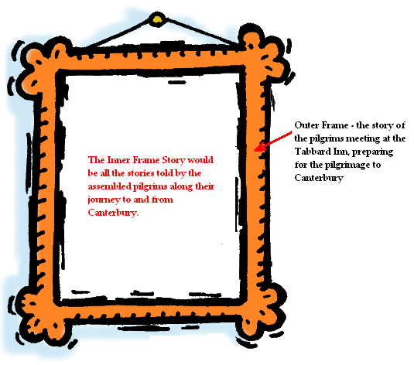
The Journey Begins . . .
The Canterbury Tales is a story about stories, twenty-four different tales set within the overarching tale of the pilgrimage.
Definition:
Frame Story – a story within a story
The Outer Frame Story is about the pilgrims meeting at the Tabard Inn preparing for a journey to Canterbury.
The Inner Frame Story would be all the stories told by the assembled pilgrims along their journey to and from Canterbury.

Slide 11
http://www.npr.org/news/graphics/2009/apr/ct_map/

Slide 12
Function of General Prologue
1. Provide general information on each pilgrim, the time and the occasion of pilgrimage.
2. Reveal the author’s purpose in telling the story.
3. Set the tone for the story-telling:
grateful acceptance of life;
make clear the plan for the tales;
motivate the telling of several tales ;
introduce the pilgrims , the time and occasion of the pilgrimage.

Slide 13
Prologue
Chaucer brings together 29 people in a religious pilgrimage.
The pilgrimage is to visit the tomb of the martyr Thomas à Beckett (killed in Canterbury Cathedral in 1170).
Pilgrimages to shrines were mass activities in the Middle Ages, partly because they were as likely to be vacations as religious observances
The group represents all classes and types of people from medieval society.
The narrator, presumably Chaucer, meets the group at the Tabard Inn.
Harry Bailey, the host of the inn, sets down a challenge for the people going on the trip:
Each pilgrim will tell two stories on the way to Canterbury and each will tell two stories on the way back. It is a contest, and the winner will be rewarded with a feast.
Notes:
By adventure (chance)
Most of these people on the journey would never have anything to do with each other socially. Differing social classes, orders, etc.
The best way for Chaucer to bring together
Makes comprehensive study of humans (his favorite subject)
Perfect way to present his special brand of irony

Slide 14
Why Canterbury?
Canterbury Cathedral was the site of a shrine to St. Thomas a Becket
Pilgrims believed relics of Becket’s shrine could heal sickness
Other reasons
Giving thanks (Knight)
Improving chances of salvation
Atonement for sins
Simple escape of travel

Slide 15
St. Thomas a Becket
Archbishop of Canterbury
Excommunicated bishops who supported King Henry II’s idea that the State could try clergy for crimes
Henry cries, “Will no one rid me of this meddlesome priest?”
4 of his knights race to Canterbury and murder Becket at the altar of the church December 29, 1170.
This battle between church and state for primacy would continue until Henry VIII broke with Rome.

Slide 16
The Pilgrimage
Started at Southwark, London
Many different pilgrimage routes started here
55 miles of dangerous, muddy, rutted, rural Roman road
Pilgrimage season began in April with the return of spring

Slide 17
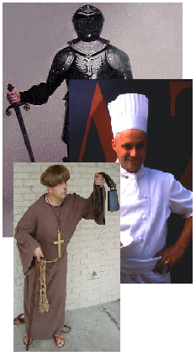
Characters and Places in Society
In the Prologue, Chaucer examines three segments of Medieval England:
1. The Old Feudal order – these are all of the pilgrims associated with the feudal class system.
Knight, Squire, Yeoman, Plowman . . .
2. The Merchant Class – this was the rising middle class of the time; towns and cities were emerging and therefore necessitated the need for skilled services:
Merchant, Man of Law, Guildsmen, Cook . . .
3. The Ecclesiastical (Church) Class – these were all of the members of the church. Chaucer is most critical of this segment of his society.
Prioress, Monk, Friar, Pardoner . . .

Slide 18
Look out for....
Physical characteristics
Medieval ideology stated that a person’s physical appearance revealed their inner character
Wife of Bath’s gap teeth, Prioress’ wide forehead
Chaucer also includes these bits to let you know that many characters aren’t doing what they should
Prioress’s pets and jewelry, Friar’s obesity, Pardoner’s long hair
Irony and Humor
Chaucer uses puns and understatement to poke fun at his Pilgrims
His humor is never cruel. He seems to recognize that all mankind has a bit of the ridiculous within.

Slide 19
The Prologue: Characters
Highest rank is aristocracy or nobility
Knight and his household, including Squire (his son)
Prioress/Nun
Monk
Friar (should be in lower class but begged so well he is now in the company of nobles)

Slide 20
The Prologue: Characters
Commercial Wealthy class
Merchant (illegally makes his money from selling French coins)
Sergeant of Law (used knowledge of law to buy up foreclosed property)
Clerk (good manners, knowledge of books)
Franklin (made enough money to be a country gentleman and push for a place of nobility)

Slide 21
The Prologue: Characters
Guildsmen
Similar to specialized unions of craftsmen or guilds:
Haberdasher (makes men’s accessories)
Dyer (dyes fabric)
Carpenter (works with wood)
Weaver (makes fabric)
Tapestry-maker (makes rugs/carpets/wall hangings
none of them tell a tale

Slide 22
The Prologue: Characters
Middle-class group
Cook (ranked too high, but he is master of his trade and respected)
Shipman (knowledge of and travels in the world)
Physician (doctor of medicine[much less revered in Middle Ages than today])
Wife of Bath

Slide 23
The Prologue: Characters
Virtuous poor or lower class
Parson (Pastor, usually of independent church)
Plowman (very poor but represents all of the Christian virtues)

Slide 24
The Prologue: Characters
Immoral lower class
Manciple (profits from buying food for the lawyers in the Inns of Court)
Miller (vulgar, steals from his customers)
Reeve (tells dirty stories and cheats his trusting young master
Summoner (corrupt, takes bribes)
Pardoner (corrupt: sells fake pardons and fake relics)

