Slide 1
The Characters of the Prologue
The Canterbury Tales

Slide 2
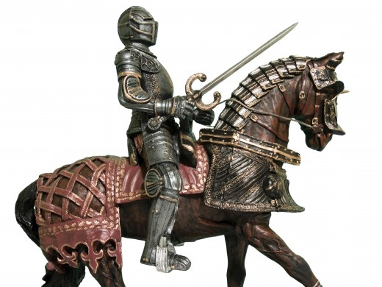
Knight
Class: Aristocracy (Lower)
Traits
Ideal Character
Keeps Order
Many War experiences (Crusades)
Humble
Horseman

Slide 3
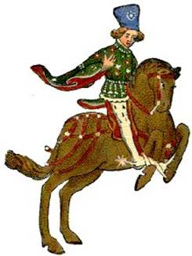
Squire
Class: Aristocracy (Lower)
Job: Attend to knight
Traits
Uses curling iron
Short gown/tight pants
Rides well
Stays out all night
Knows how to court women

Slide 4
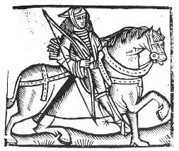
Yeoman
Class: Aristocracy (Lower)/Middle Class
Job: Servant to a nobleman
Traits
Dresses in green
Well kempt
Idealized to a degree
Works with wood
Wears image of St. Christopher (Relic to guard against death/weariness)

Slide 5
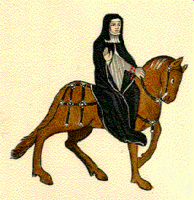
Prioress
Class: Clergy (Once Aristocracy)
Job: Leader of convent
Traits
Head of order, not supposed to travel
Swears by St. Eligius (not supposed to)
Leads secular life, not holy
Poor French
Good manners
Loves animals, treats better than humans

Slide 6
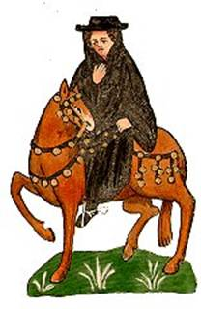
Monk
Class: Clergy (Perhaps once aristocracy)
Job: Serve the church
Traits
Loves hunting
Compromised vows of poverty and obedience
Enjoys eating

Slide 7
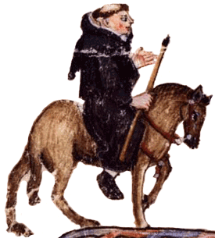
Friar (Hubert)
Class: Clergy
Job: Beg, serve church among people
Traits
Friars supposed to live in absolute poverty…don’t.
Tension between friars and other religious leaders
Lisp
Seduces women then marries them off

Slide 8
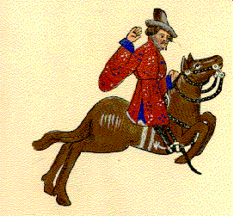
Merchant
Class: Middle Class
Job: Selling and Trading
Traits
Finely Dressed
Shrewd Businessman
In serious financial trouble but no one knows

Slide 9
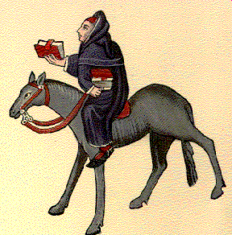
Oxford Cleric
Class: Middle Class
Job: Student – To learn
Traits
University Student. Needed to be male and member of clergy at some point to attend.
Perpetual student. Too “spiritual” to seek secular employment.

Slide 10
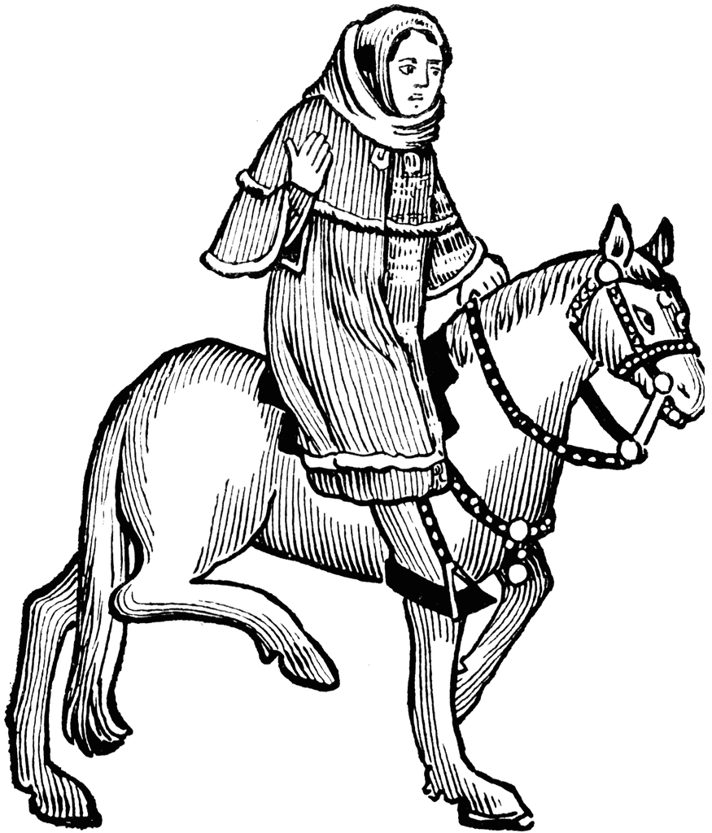
Lawyer
Class: Middle Class
Job: Practice Law
Traits
“Seems” wise
No one could prove his work or purchases incorrect because they were complex
“Seems” to work hard

Slide 11
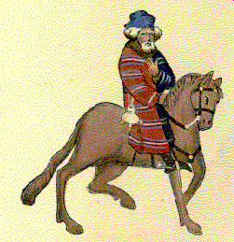
Franklin (Land owner)
Class: Middle Class
Job: Land owner (though not a noble)
Traits
Nobleman of the country
Public servant (Knight of the shire)
Always has dinner table prepared.
Sanguine (happy/cheerful/optimistic)

Slide 12
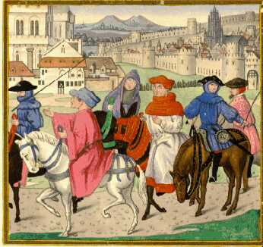
Guildsmen
Class: Middle Class
Job: Tradesmen/People who work in a trade
Traits
Haberdasher (men’s clothing), carpenter, weaver (fabric for clothes), dyer, tapestry weaver (fabric art for decoration)
Rich
Wearing fine clothes
Bring own cook

Slide 13
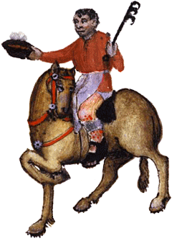
Cook
Class: Middle Class
Job: Prepare food
Traits
Cook to the guildsmen
Excellent at his job
Sore/ulcer on leg

Slide 14
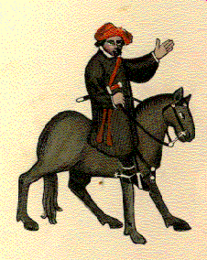
The Skipper
Class: Middle Class
Job: Captain of boat
Traits
Good fellow – but his methods are questionable
Deals/trades wine
Tough guy – wears knife
Firm leader – Sends people overboard

Slide 15
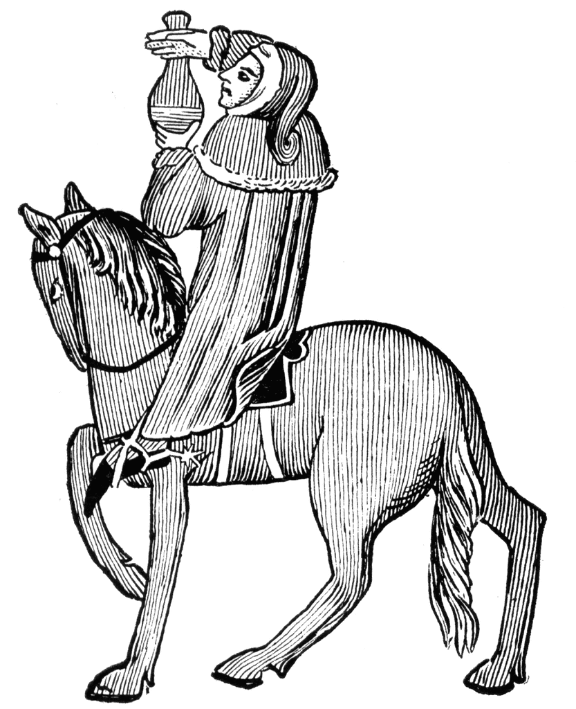
The Doctor
Class: Middle Class
Job: Doctor
Traits
Knows authorities in his field (well read)
Uses astrology to diagnose
Ongoing scam with pharmacist (Diagnose and get a cut)
Fancy clothes
Does not study Bible
Loves gold

Slide 16
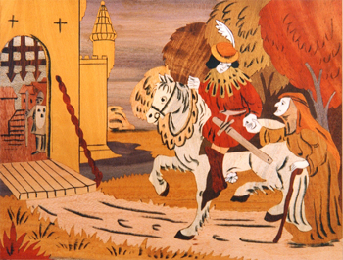
The Wife of Bath
Class: Middle Class
Job: Professional wife???
Traits
Partially deaf (Hears some things not others)
Cloth maker
Wealthy
Goes to church to be seen
Wearing tight, red, visible stockings
Gap tooth (sexuality)
Enjoys riding
Love making

Slide 17
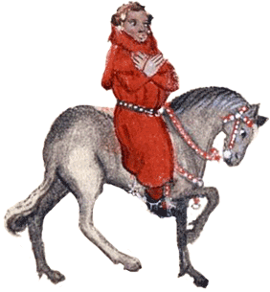
The Parson
Class: Clergy/Lower Class
Job: Serve church among people
Traits
Wants to be preacher
Patient and diligent
Rarely excommunicates due to how bad it is
Gives to poor
Visits sick
Imitates Christ
Practices what he preached
Knows significance of his position

Slide 18
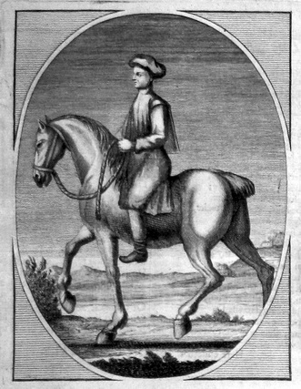
The Plowman
Class: Lower Class
Job: Work the land/farm
Traits
Works in the name of God
Pays tithes properly

Slide 19
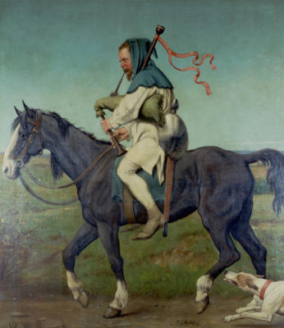
The Miller
Class: Middle Class
Job: Works in grain mill
Traits
Large man
Works with and cheats with wheat
Plays bagpipe
Wart on face
Leads group out of town

Slide 20
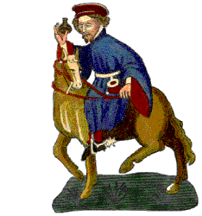
The Manciple
Class: Middle Class
Buys supplies for institutions
Traits
Steward of law school
Not as intelligent as his students
Skims money for himself

Slide 21
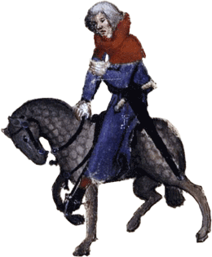
The Reeve (Oswald)
Class: Middle Class
Job: Local official of town or district
Traits
Slender
Choleric (ambitious/leader/aggressive)
Used to be a carpenter

Slide 22
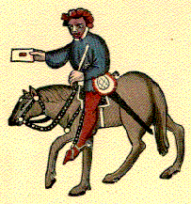
The Summoner
Class: Clergy
Job: Bring lawbreakers to court
Traits
Summons people to ecclesiastical court
Lecherous
Skin issues/break out

Slide 23
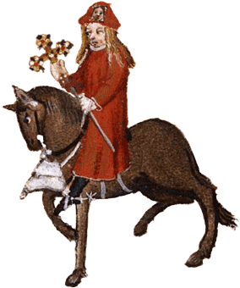
The Pardoner
Class: Clergy
Job: Grants people forgiveness for sin/ability to break church law
Traits
Small voice like goat
Could not grow beard
A gelding (castrated horse) or mare

Slide 24
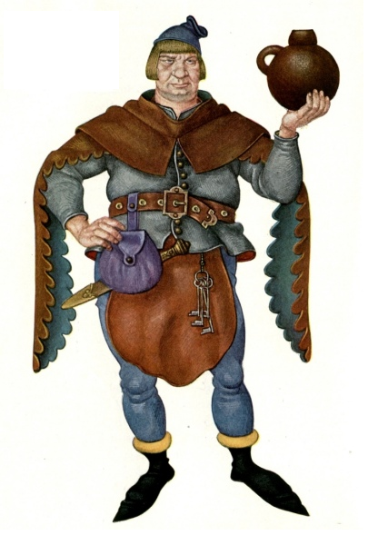
The Host
Class: Middle Class
Job: Runs an inn
Traits
Will judge the tales
Owns inn
Good looking, commanding person
Good sense of humor
Thought highly of.

