Slide 1
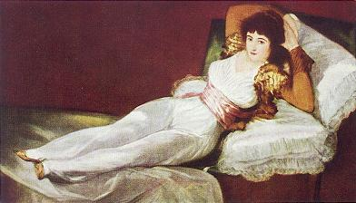
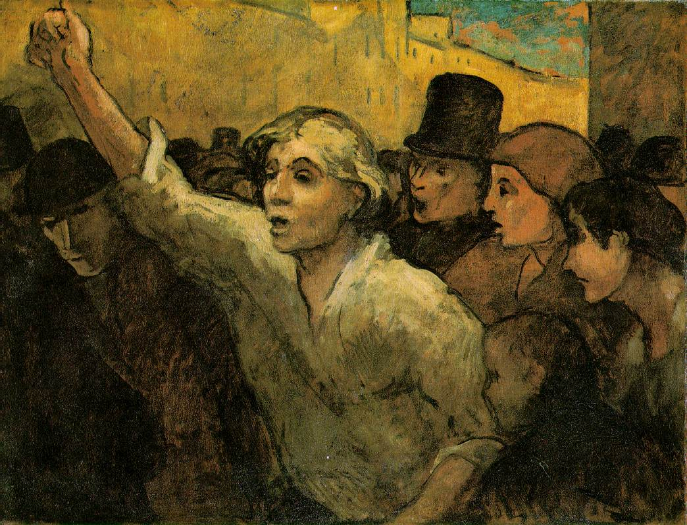
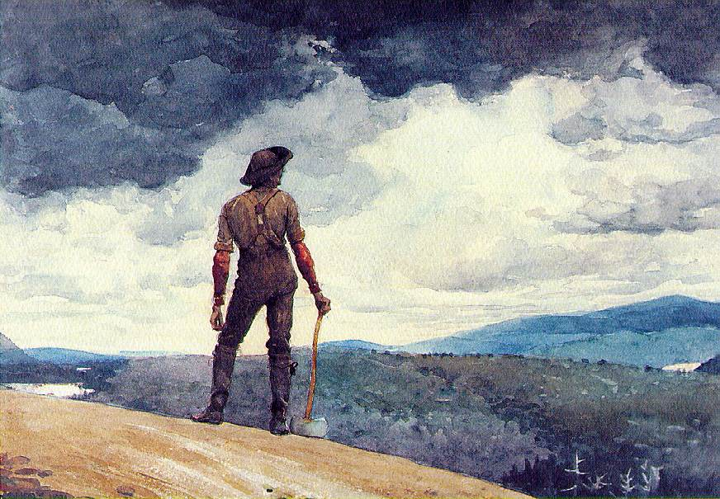
The Romantic Era

Slide 2
Historical Background
French Revolution promotes liberty, equality, and fraternity
Jean-Jacques Rousseau: Calls for social democracy. Claims that wealth and society corrupt man. Individuals must get away.
England denounces French revolution, and revolution in general.
Urbanization occurs.
Industrial Revolution getting under way.
Disparity between rich and poor.
1776 – American Revolution
1789 – French Revolution

Slide 3
Historical Background
Fight for democracy, republicanism, equality, social rights, fair wealth distribution
Citizens yearn for hero. As Napoleon rises, nationalism rises.
Middle class desires rights, freedoms, basic necessities.
Some believed Napoleon would supply these things, others did not.
Many romantics changed their minds about Revolution and Napoleon as events unfolded.

Slide 4
Definition
Romanticism – 1790’s to 1830’s
A reactionary movement in society against the demanded order of the preceding time period. (Literature, philosophy, art, religion, and politics)
The prior period valued reason, formal rules, and demanded order in beauty.
Romanticism valued spontaneity, freedom, internal inspiration, and emotions

Slide 5
Romanticism in the Arts
The romantics sought to express their personal
feelings in their works rather than search for some kind of
philosophical or religious "truth."
Many felt a special regard for nature, believing that it made human achievements seem small.
Many identified with the nationalist movements of the times and either
supported their own country's fight for freedom
or championed the cause of others (Byron).
Years: 1790’s to 1830’s.

Slide 6
Characteristics of Romanticism
Imagination over reason and formal rules
Love of nature
Individualism
Enthusiasm for the wild, irregular, or grotesque
Gothic themes
Glorification of the commonplace
Nationalism

Slide 7
Role of Nature in Romanticism
Multiple perspectives on nature:
Source of inspiration
Refuge from civilization
Something to revere, stand in awe of
Healthy to meditate upon

Slide 8
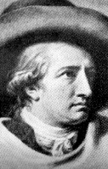
Romanticism in Literature
In literature no figure dominated his time more than
Johann Wolfgang von Goethe, the German poet, dramatist, and
novelist.
The scale of his writings runs from the most
intimate love lyrics to works that border on epic status.
Johann Wolfgang von Goethe
Notes:
Johann Wolfgang von Goethe (1749-1832)
Johann Wolfgang von Goethe
THE boy, Goethe, was a precocious youngster. At the early age of eight he had already acquired some knowledge of Greek, Latin, French and Italian. He had likewise acquired from his mother the knack of story telling; and from a toy puppet show in his nursery his first interest in the stage.
Goethe's early education was somewhat irregular and informal, and already he was marked by that apparent feeling of superiority that stayed by him throughout his life. When he was about 16 he was sent to Leipzig, ostensibly to study law. He apparently studied more life than law and put in his time expressing his reactions through some form of writing. On at least two occasions, this form was dramatic.
Finally, in 1770 Goethe went to Strassburg, this time really intent on passing his preliminary examinations in law, and with the somewhat more frivolous ambition of learning to dance. Along with his study of law, he studied art, music, anatomy and chemistry. A strong friendship with the writer, Herder, was likewise no part of Goethe's experience at this time, a contact which was of considerable importance in these formative years.
In 1771 Goethe returned to Frankfurt, nominally to practice law, but he was soon deep in work on what was to be his first dramatic success, Götz von Berlichingen. While this was actually the story of a robber baron of the 16th century it really represented Goethe's youthful protest against the established order and his demand for intellectual freedom. Its success made its hitherto unknown author the literary leader of Germany.
Goethe's invitation in 1775 to the court of Duke Karl August at Weimar was a turning point in the literary life of Germany. He became manager of the Court Theater, and interested himself in various other activities, so that for a period of some ten years not much actual writing was done.
The writing of Faust, however, that best known of Goethe's works, extended over practically the whole of Goethe's literary life, a period of 57 years. It was finally finished when Goethe was 81. Faust is in reality a dramatic poem rather than a piece for the stage. While based on the same legend as Marlowe's Dr. Faustus, it far transcends both its legendary source and the English play. The latter is little more than a Morality illustrating the punishment of sin; Goethe's work is a drama of redemption.
Others of Goethe's works which have stood the test of time include: Clavigo, Egmont, Stella, Iphigenia in Tauris and Torquato Tasso.
…………………..
German poet, novelist, playwright, courtier, and natural philosopher, one of the greatest figures in Western literature. In literature Goethe gained early fame with The Sorrows of Young Werther (1774), but his most famous work is the poetic drama in two parts, FAUST. Like the famous character of this poem, Goethe was interested in alchemy. He also made important discoveries in connection with plant and animal life, and evolved a non-Newtonian and unorthodox theory of the character of light and color, which has influenced such abstract painters as Kandinsky and Mondrian.
Noble be man, Helpful and good! For that alone Sets him apart From every other creature On earth. (from The Divine, 1783) Johann Wolfgang von Goethe was born in Frankfurt am Main, the first child of a lawyer Johann Caspar Goethe, and Katherine Elisabeth Textor, the daughter of the mayor of Frankfurt. Goethe had a comfortable childhood and he was greatly influenced by his mother, who encouraged his literary aspirations. After troubles at school, he received at home an exceptionally wide education. At the age of 16, Goethe began to study law at Leipzig University (1765-68), and he also studied drawing with Adam Oeser. An unhappy love affair inspired Goethe's first play, The Lover's Caprice (1767). After a period of illness, Goethe resumed his studies in Strasbourg (1770-71). Some biographers have speculated that Goethe had contracted syphilis - at least his relationships with women were years apart. Goethe practised law in Frankfurt (1771-72) and Wetzlar (1772). He contributed to Frankfurter Gelehrte Anzeigen (1772-73), and in 1774 he published his first novel, self-revelatory DIE LEIDEN DES JUNGEN WERTHERS (The Sorrows of Young Werther), in which he created the prototype of the Romantic hero. The novel, written in the form of a series of letters, depicted the hopeless affair of a young man, Werther, with the beautiful Charlotte. In the end the melancholic Werther romantically commits suicide, after one brief moment of happiness with Charlotte, when she lets him kiss her. Goethe's model was Charlotte Buff, the fiancée of his friend, whom he had met in Wetzlar in 1772.
Goethe's youth was emotionally hectic to the point that he sometimes feared for his reason. He was recognized as a leading figure in the Sturm und Drang, which celebrated the energetic Promethean restlessness of spirit as opposed to the ideal of calm rationalism of the Enlightenment. Goethe's poem 'Prometheus', with its insistence that man must believe not in gods but in himself, might be seen as a motto for the whole movement. After a relaxing trip to Switzerland, Goethe made a decisive break with his past. In 1775 he was welcomed by Duke Karl August into the small court of Weimar, where he worked in several governmental offices. Occasionally he read aloud his texts to a selected group of persons - among them the Duke and the two Duchesses. To his disappointment a dog-trainer was also allowed to amuse in the court theatre.
"What you don't feel, you will not grasp by art, Unless it wells out of your soul And with sheer pleasure takes control, Compelling every listener's heart. But sit - and sit, and patch and knead, Cook a ragout, reheat your hashes, Blow at the sparks and try to breed A fire out of piles of ashes! Children and apes may think it great, If that should titillate your gum, But from heart to heart you will never create. If from your heart it does not come." (from Faust I) In Weimar Goethe did not have much time to publish fiction. He was a council member and member of the war commission, director of roads and services, and managed the financial affairs of the court. Also Goethe's scientific researches were wide. He discovered the human intermaxilarry bone (1784), and formulated a vertebral theory of the skull. His idea of Urpflanze, the archetypal forms after which all other plants are patterned, has similarities with Plato's theory of eternal and changeless Forms. In general, Goethe's metaphysics and organic view of nature showed the influence of Spinoza.
During this period, his great love was Charlotte von Stein, an older married woman, but the relationship remained platonic. Eventually Goethe was released from day-to-day governmental duties to concentrate on writing, although he was still general supervisor for arts and sciences, and director of the court theatres. After Goethe's emotional dependence on Charlotte ended, he lived happily and unmarried with Christiane Vulpius, who became Goethe's mistress in 1789. In spite of public pressure, it was not until 1806 when they married.
In 1786-88 Goethe made a journey to Italy. "In Rome I have found myself for the first time," he wrote. He drew statues and ruins, collected antique and botanical samples, and was shocked by the primitive power of an ancient Greek temple - Renaissance art did not interest him. The journey ended Goethe's celibacy and inspired his play IPHIGENIE AUF TAURIS, and RÖMISHE ELEGIEN, sensuous poems relating partly to Christiane. The ancient monuments he saw in Italy significantly influenced his growing commitment to a classical view of art. "Three things are to be looked to in a building," Goethe later wrote in Elective Affinities (1808), "that it stands on the right spot; that it be securely founded; that it be successfully executed."
In the 1790s Goethe contributed to Friedrich von Schiller´s journal Die Horen, published WILHELM MEISTERS LEHRJAHRE (Wilhelm Meister's Apprenticeship) in 1795-96, and continued his writings on the ideals of arts and literature in his own journal Propyläen. Wilhelm Meister's story had preoccupied the author for many years. Wilhelm, disillusioned by love, starts actively to seek out other values, and becomes an actor and playwright. Whereas Werther's life ended in despair, Meister has a more optimistic spirit. At the end he says: "... I know I have attained a happiness which I have not deserved, and which I would not change with anything in life." Wim Wenders and Peter Handke made in 1974 a modernized film adaptation of the book, Wrong Movement, in which Meister's journey has a sad, lonely note. "If only politics and poetry could be united," he says to his friend Laertes, who answers: "That would be the end of longing and the end of the world."
During the French Revolution Goethe reported in letters - sometimes written in the middle of cannon fire - to his family his inconveniences, complaining that he was forced to leave his home and dear garden after the French army attacked Prussia. He also saw killings and looted villages. Although Goethe supported freedom and progress, he wanted to preserve the bourgeois or his artistic-individualistic way of life. However, the majority of the German intelligentsia greeted with enthusiasm the goals of the revolution, including Kant, Schiller, and Friedrich Schlegel.
Faust is an alchemical drama from beginning to end, claims C.G. Jung. Goethe worked for most of his life on this masterwork. He started to compose Faust about the age of twenty-three, and finished the second part in 1832, just before his death. The original figure in the Faust legend was Gregorius Faustus (or Gregorius Sabellicus, Faustus Junior, c1480-1510/1), a seeker of forbidden knowledge. His true identity is not known, but he claimed to be an astrologer, expert in magic, and an alchemist. This legend attracted Christopher Marlowe, who offered in his play a psychological study of the battle between good and evil. Marlowe's drama ends with the protagonist's damnation. Goethe's story created a new persona for the Devil - Mephistopheles was a gentleman, who had adopted the manners of a courtier. Faust's lust for knowledge is limitless and he makes a contract with Mephistopheles: he will die at the moment he declares himself satisfied, if he should exclaim, "Stay, thou art so fair." When Werther believed that his passion for beauty is fulfilled in afterlife, Faust wants to enjoy his highest moment in this life.
In the first part, published in 1808, Faust seduces and loses Margaret (in German, Margarete, or its diminutive, Gretchen), an innocent girl, who is condemned to death for murdering her illegitimate child by Faust. When she asks Faust, "Do you believe in God?", he answers: "Does not the heaven vault above? / Is the earth not firmly based down here? / And do not, friendly, / Eternal stars arise? / Do we not look into each other's eyes, / And all in you is surging, / To your head and heart, / And weaves in timeless mystery, / Unseeable, yet seen, around you?"
In the philosophical second part Faust marries Helen of Troy and starts to create an ideal community. Harold Bloom has said in The Western Canon (1994), that the monstrously complex poem is a "scandalous pleasure for the exuberant reader, but it is also a trap, a Maphistophelean abyss in which you will never touch bottom." Without knowing that his plans have failed, the blind Faust is finally satisfied. However, Mephistopheles loses his victory, when angels take Faust to heaven. - Faust versions: Gotthold Lessing's (1729-1781) lost play Faust, Don Juan/Don Giovanni (perhaps best known from the Opera by Lorenzo Ponte and Wolfgang Amadeus Mozart), Oscar Wilde's novel The Picture of Dorian Gray, Dorothy L. Sayers's play The Devil to Pay (1939), Thomas Mann's novel Doctor Faustus (1947). - Film adaptations: 1926, dir. by F.W. Murnau; film All That Money Can Buy, 1941, dir. by William Dieterle, based on Stephen Vincent Benét work; 1949, dir by René Clair (La Beauté du Diable); 1974, dir. by Brian DePalma (Phantom of the Paradise, based loosely on Gaston Leroux's novel Phantom of the Opera). - Opera: Gounod's Faust (1859), Buïto's Mefistotele (1866), Berlioz's La Damnation de Faust (1893), Busoni's Doktor Faust (1925) - Animation: 1994, dir.by Jan Svankmaijer.
From 1791 to 1817 Goethe was the director of the court theatres. He advised Duke Carl August on mining and Jena University, which for a short time attracted the most prominent figures in German philosophy, including Hegel and Fichte. In 1812 Goethe met the famous composer Ludwig van Beethoven in Teplitz. Beethoven had admired Goethe already in his youth, although he considered Goethe's attitude toward the nobility too servile. Beethoven composed several music pieces based on the author's texts, among them Egmont. Franz Schubert's (1797-1828) first Lieder masterpiece, 'Gretchen am Spinnrade', took the words from Faust, but Goethe did not much appreciate Schubert's musical achievements.
Goethe remained creative during his last period. He edited Kunst and Altertum (1816-32) and Zur Naturwissenschaft (1817-24), wrote his autobiography, Poetry and Truth (1811-1833), and completed the novel WILHELM MEISTERS WANDERJAHRE (1821-9). Interested in visual arts throughout his life, Goethe wrote a large volume on the theory of color, which he considered one of his major achievements. In ZUR FARBENLEHRE (1810) Goethe rejected mathematical approach in the treatment of color, and argued that light, shade and color are associated with the emotional experience - "every color produces a distinct impression on the mind, and thus addresses at once the eye and feelings".
At the age of 74 Goethe fell in love with the 19-year old Ulrike von Levetzow. He followed her with high hopes from Marienbad to Karlsbad, and then returned disappointed to Weimar. There he wrote The Marienbad elegy, the most personal poem of his later years. Goethe died in Weimar on March 22, 1832. He and Schiller, who died over a quarter of a century earlier, are buried together, in a mausoleum in the ducal cemetery. The Goethe House and Schiller House stand in the town, and the two statues of these literary giants are outside the National Theatre.

Slide 9
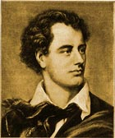
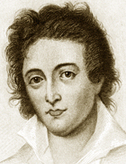
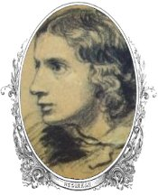
The Romantic Poets and the Novel
The English romantic poets:
William Wordsworth, Percy Bysshe Shelley, John Keats, and Lord Byron (George Gordon), Samuel Coleridge, and William Blake touched on all the principal romantic themes.
Other English writers, such as Charles Dickens and Emily Bronte, used the novel as a means of expressing
their concerns.
Lord George
Gordon Byron
John Keats
Percy Bysshe Shelly
Notes:
Lord George Gordon Byron (1788-1824) was as famous in his lifetime for his personality cult as for his poetry. He created the concept of the 'Byronic hero' - a defiant, melancholy young man, brooding on some mysterious, unforgivable event in his past. Byron's influence on European poetry, music, novel, opera, and painting has been immense, although the poet was widely condemned on moral grounds by his contemporaries. George Gordon, Lord Byron, was the son of Captain John Byron, and Catherine Gordon. He was born with a club-foot and became extreme sensitivity about his lameness. Byron spent his early childhood years in poor surroundings in Aberdeen, where he was educated until he was ten. After he inherited the title and property of his great-uncle in 1798, he went on to Dulwich, Harrow, and Cambridge, where he piled up debts and aroused alarm with bisexual love affairs. Staying at Newstead in 1802, he probably first met his half-sister, Augusta Leigh with whom he was later suspected of having an incestuous relationship. In 1807 Byron's first collection of poetry, Hours Of Idleness appeared. It received bad reviews. The poet answered his critics with the satire English Bards And Scotch Reviewersin 1808. Next year he took his seat in the House of Lords, and set out on his grand tour, visiting Spain, Malta, Albania, Greece, and the Aegean. Real poetic success came in 1812 when Byron published the first two cantos of Childe Harold's Pilgrimage (1812-1818). He became an adored character of London society; he spoke in the House of Lords effectively on liberal themes, and had a hectic love-affair with Lady Caroline Lamb. Byron's The Corsair (1814), sold 10,000 copies on the first day of publication. He married Anne Isabella Milbanke in 1815, and their daughter Ada was born in the same year. The marriage was unhappy, and they obtained legal separation next year. When the rumors started to rise of his incest and debts were accumulating, Byron left England in 1816, never to return. He settled in Geneva with Percy Bysshe Shelley, Mary Shelley, and Claire Clairmont, who became his mistress. There he wrote the two cantos of Childe Harold and "The Prisoner Of Chillon". At the end of the summer Byron continued his travels, spending two years in Italy. During his years in Italy, Byron wrote Lament Of Tasso, inspired by his visit in Tasso's cell in Rome, Mazeppa and started Don Juan, his satiric masterpiece. While in Ravenna and Pisa, Byron became deeply interested in drama, and wrote among others The Two Foscari, Sardanapalaus, Cain, and the unfinished Heaven And Earth. After a long creative period, Byron had come to feel that action was more important than poetry. He armed a brig, the Hercules, and sailed to Greece to aid the Greeks, who had risen against their Ottoman overlords. However, before he saw any serious military action, Byron contracted a fever from which he died in Missolonghi on 19 April 1824. Memorial services were held all over the land. Byron's body was returned to England but refused by the deans of both Westminster and St Paul's. Finally Byron's coffin was placed in the family vault at Hucknall Torkard, near Newstead Abbey in Nottinghamshire.
….
Percy Bysshe Shelley (1792-1827), English Romantic poet who rebelled against English politics and conservative values. Shelley drew no essential distinction between poetry and politics, and his work reflected the radical ideas and revolutionary optimism of the era. Percy Bysshe Shelley was born on August 4, 1792, at Field Place, near Horsham in Sussex, into an aristocratic family. His father, Timothy Shelley, was a Sussex squire and a member of Parliament. Shelley attended Syon House Academy and Eton and in 1810 he entered the Oxford University College. In 1811 Shelley was expelled from the college for publishing The Necessity Of Atheism, which he wrote with Thomas Jefferson Hogg. Shelley's father withdrew his inheritance in favor of a small annuity, after he eloped with the 16-year old Harriet Westbrook, the daughter of a London tavern owner. The pair spent the following two years traveling in England and Ireland, distributing pamphlets and speaking against political injustice. In 1813 Shelley published his first important poem, the atheistic Queen Mab. The poet's marriage to Harriet was a failure. In 1814 Shelley traveled abroad with Mary Wollstonecraft Godwin, the daughter of the philosopher and anarchist William Godwin (1756-1836). Mary's young stepsister Claire Clairmont was also in the company. During this journey Shelley wrote an unfinished novella, The Assassins (1814). Their combined journal, Six Weeks' Tour, reworked by Mary Shelley, appeared in 1817. After their return to London, Shelley came into an annual income under his grandfather's will. Harriet drowned herself in the Serpentine in 1816. Shelley married Mary Wollstonecraft and his favorite son William was born in 1816. Shelley spent the summer of 1816 with Lord Byron at Lake Geneva, where Byron had an affair with Claire. Shelley composed the "Hymn To Intellectual Beauty" and "Mont Blanc". In 1817 Shelley published The Revolt Of Islam and the much anthologized "Ozymandias" appeared in 1818. Among Shelley's popular poems are the Odes "To the West Wind" and "To a Skylark" and Adonais, an elegy for Keats. In 1818 the Shelleys moved to Italy, where Byron was residing. In 1819 they went to Rome and in 1820 to Pisa. Shelley's works from this period include Julian And Maddalo, an exploration of his relations with Byron and Prometheus Unbound, a lyrical drama. The Cenci was a five-act tragedy based on the history of a 16th-century Roman family, and The Mask Of Anarchy was a political protest which was written after the Peterloo massacre. In 1822 the Shelley household moved to the Bay of Lerici. There Shelley began to write The Triumph Of Life. To welcome his friend Leigh Hunt, he sailed to Leghorn. During the stormy return voyage to Lerici, his small schooner the Ariel sank and Shelley drowned with Edward Williams on July 8, 1822. The bodies were washed ashore at Viareggio, where, in the presence of Lord Byron and Leigh Hunt, they were burned on the beach. Shelley was later buried in Rome. …………………
John Keats (1795-1821), English lyric poet, usually regarded as the archetype of the Romantic writer. Keats felt that the deepest meaning of life lay in the apprehension of material beauty, although his mature poems reveal his fascination with a world of death and decay. Keats was born in London on October 31, 1795 as the son of a livery-stable manager. He was the oldest of four children, who remained deeply devoted to each other. After their father died in 1804, Keats's mother remarried but the marriage was soon broken. She moved with the children, John and his sister Fanny and brothers George and Tom, to live with her mother at Edmonton, near London. She died of tuberculosis in 1810. At school Keats read widely. He was educated at Clarke's School in Enfield, where he began a translation of the Aeneid. In1811 he was apprenticed to a surgeon-apothecary. His first poem, "Lines in Imitation of Spenser", was written in 1814. In that year he moved to London and resumed his surgical studies in 1815 as a student at Guy's hospital. Next year he became a Licentiate of the Society of Apothecaries. Before devoting himself entirely to poetry, Keats worked as a dresser and junior house surgeon. In London he had met the editor of The Examiner, Leigh Hunt, who introduced him to other young Romantics, including Shelley. His poem, "O Solitude", also appeared in The Examiner. Keats's first book, Poems, was published in 1817. It was about this time Keats started to use his letters as the vehicle of his thoughts of poetry. "Endymion", Keats's first long poem appeared, when he was 21. Keats's greatest works were written in the late 1810s, among them "Lamia", "The Eve of St. Agnes", the great odes including "Ode to a Nightingale", Ode To Autumn" and "Ode on a Grecian Urn". He worked briefly as a theatrical critic for The Champion. Keats spent three months in 1818 attending his brother Tom, who was seriously ill with tuberculosis. After Tom's death in December, Keats moved to Hampstead. In the winter of 1818-19 he worked mainly on "Hyperion". In 1820 the second volume of Keats poems appeared and gained critical success. However, Keats was suffering from tuberculosis and his poems were marked with sadness partly because he was too poor to marry Fanny Brawne, the woman he loved. Declining Shelley's invitation to join him at Pisa, Keats went to Rome, where he died at the age of 25, on February 23, 1821. Keats told his friend Joseph Severn that he wanted on his grave just the line, "Here lies one whose name was writ in water."

Slide 10
Individualism
Middle Ages: Emphasis on God. Man lives for afterlife.
Renaissance: Man is center of all concern.
Enlightenment: Universal characteristics of humanity
Romanticism: Man is individual, special, and needs solitude.
Values exploration and evaluation of inner self.

