Slide 1
Restoration & 18th Century 1660-1785
Based on Norton Anthology of English Lit 8th edition

Slide 2
In the Shadow of Elizabeth
After James I, his weak son Charles I came to throne, but the Puritans and their parliamentary party had gained power.
By 1642 England was embroiled in civil war between the parliamentary party and the Royalists.
Charles I was Beheaded by Parliament as they took over England under the rule of Oliver Cromwell—not royalty but a military and political strategist who eventually tore up the constitution and became a dictator.
The Restoration refers to the restoring of power to the monarchy (lineage of kings) in England. Charles II was restored to power in 1660 following Oliver Cromwell’s death beginning a time period known as the Restoration.

Slide 3
Line of Royalty
The Tudors
Queen Elizabeth I 1558 - 1603
The Stuarts (1603 - 1649) (1660 - 1714)
James I 1603 - 1625
Charles I 1625 – 1649
(Cromwell)
Charles II 1660 - 1685
James II 1685 - 1688

Slide 4
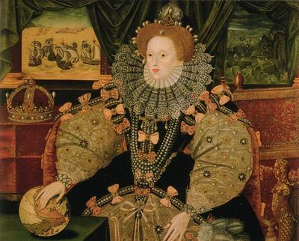
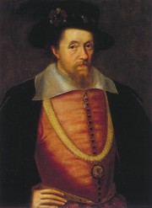
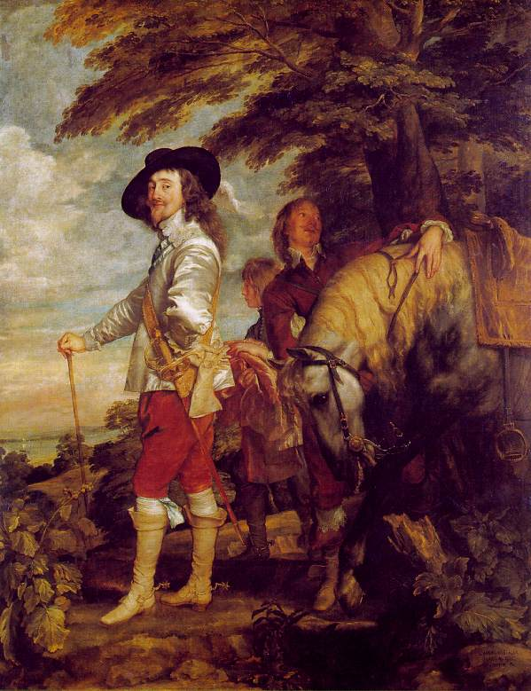
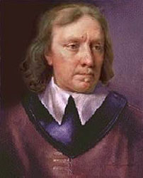
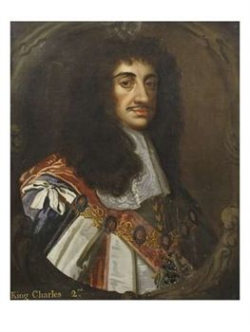
The Players
Elizabeth I
Charles I
James I
Oliver Cromwell
Charles II

Slide 5
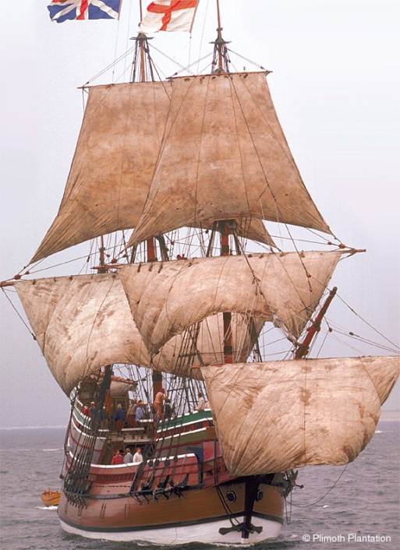
The Growth of the United States
People move from England and Europe to North America
Freedom of Religion
Ambition—money to be made in furs, tobacco, logging for the building of ships
Transporting Africans for use as slave labor.

Slide 6
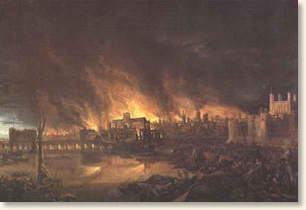
Defeated and Exhausted
By 1660 England was utterly exhausted by 20 years of civil war.
By 1700 it had lived through a devastating plague and a fire that had left more than 2/3 of Londoners homeless.

Slide 7
Religion and Politics
Political and Religious unrest across Europe.
Leaders will not tolerate dissent.
Widespread anti-catholic sentiment; blamed for the fire of London and fictional “popish plot”.
James II, King of England and Catholic, did not hide his sympathies as his father (Charles II) had. He is ousted.

Slide 8
Emergency of Empire
First prime ministers of England expand British power and commerce overseas.
Britain becomes colonial power, ruling Canada and India, loses American colonies.
Slave trade makes nation rich; opposition to slavery widespread by many religious groups, specifically Anglicans and Methodists.

Slide 9
Discontent: The rich get richer
Unequal distribution of wealth; women remain disenfranchised
1780 London riots turn the poor (Catholic and Protestant) against each other.
Fear of radicals who call for new democracy contributes to British reaction against French revolution.

Slide 10
The Emergence of Science
Major increase in scientific knowledge.
Scientific study becoming more pervasive/effective as a discipline.
Microscope and telescope expand mankind’s knowledge of the complexity of the universe
Exploration and colonization increase appetite for facts about wildlife, plants, and resources.

Slide 11
Science
Discovery and analysis of electricity leads to experiments with electrocution
First steam powered factories.
Knowledge of Chemistry improves, discipline pursued more thoroughly.

Slide 12
Deism or “Natural Religion”
Newton’s discoveries suggest “universal order in creation” created by God like a watchmaker.
Created but not involved.
Deists promote “universal” religious tenets that could be embraced by rational beings.
Believe that Reason recognizes goodness, wisdom of God and natural law. See no need for mystery or Religious texts.
American Founders like Ben Franklin embraced Deism.

Slide 13
Religion
Methodism - Evangelical sect promoted by John Wesley. Focuses on faith, diminishes role of works.
Gives less value to church tradition, instead relying on Bible as only true source of religious knowledge.
New emphasis on individual and personal God: diary keeping, letter writing, and novel “all testify to importance of private, individual life”

Slide 14
New professional writing class
Journalism, news reporting, gossip columns arise.
More authors begin to write for pay
Mostly wealthy or middle class, but some poor authors made it into print.

Slide 15
Cost of reading
Books were still too expensive for laborers, as were lending libraries.
Poor sometimes taught to read as a religious activity by aristocratic masters.
Patrons interested in letters, travel literature, and novels
Change of printing: capitalization reserved for proper names instead of nouns; fewer italics for emphasis suggests more sophisticated reading public

Slide 16
Literary Principles: New emphasis on Clarity
Writing showed simplicity and restraint.
Marks a rejection of Milton’s large themes.
Interest in literature for moral instruction rises.

Slide 17
18th Century lit 1700-1745
Great age of satire: Writers use wit to attack current issues/events.
Satire - A literary work which attacks people or ideas through ridicule, derision, irony, sarcasm, wit, or humor in an attempt to bring about a change.
Prose becomes a legitimate form of literature. More popular than poetry for the first time ever.
New genres arise: Allegories, criminal biographies, travelogues, gossip, romance – Often fictionalized.
Poems about sublime beauties of nature hint at the coming romantic age.

Slide 18
Realistic Fiction
Pinnacle of 18th century English literature is fiction.
England produces three greatest realistic novelists.
Daniel Defoe, father of modern novel and the author of Robinson Crusoe.
Jonathan Swift, the greatest English satirist and the author of Gulliver’s Travels.
Henry Fielding, the author of Tom Jones.

Slide 19
Sentimentalism
Precursor to Romanticism.
Arose in the middle of the 18th century.
The result of discontent with social reality and reason.
Sentimentalists appeal to sentiment, "the human heart.'
Sentimentalism turned to nature and the countryside for its material.

